Slide 1

How Can a Wellness Technology Company Play It Smart?
ALLAN C MATHEWS
March 2022

Slide 2
Problem:
Solution:
Sporadic or nonexistent communication between teachers & parents
Help the middle school design an app for parents to stay updated on school news and their children’s classes and activities.

Slide 3
Analytical goals
WHY: Quantity impact on student test scores
HOW: Identify what parents want to know about

Slide 4
Analytical goals
WHY: Quantity impact on student test scores
HOW: Identify what parents want to know about

Slide 5
100
Downward Trend
Student test scores have been falling since 2004.
Average test scores (%)
0
2004
Year
2018
Source: Average test scores from 2004-2018 annual state mandated tests at the end of the year (n=500 students)

Slide 6
91%
+14pp
The Reason
Parental involvement has also dropped since 2004, despite a +14pp impact on average test scores.
77%
Parents in PTA
Parents not involved
Source: Average test scores from 2004-2018 annual state mandated tests at the end of the year (n=160 students)

Slide 7
Thus, we need to increase parental involvement to improve student test scores.

Slide 8
Analytical goals
WHY: Quantity impact on student test scores
HOW: Identify what parents want to know about

Slide 9
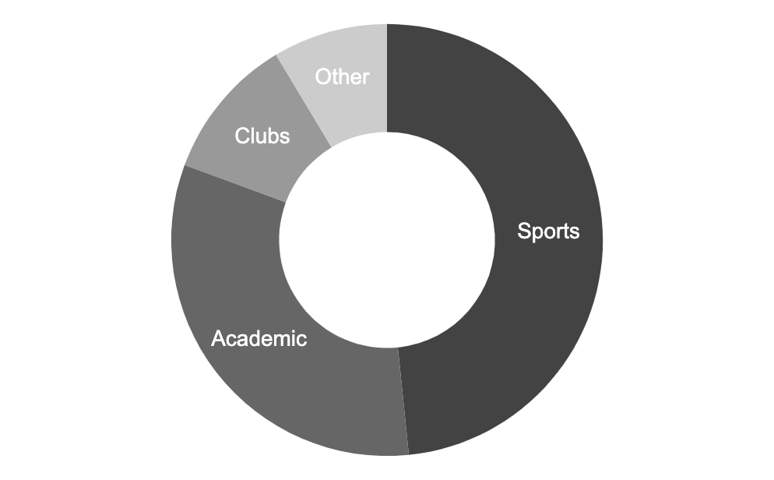
Student Activities
Most student activities can be grouped into 3 categories: sports, academics, and extracurricular clubs.
Source: 2018 survey asking student what activities they are involved in during school hours (n=350 students)

Slide 10
30
Prioritize 7th Graders
Currently, 7th graders receive the least attention with the fewest number of news alerts published.
26
16
For 6th graders
For 7th graders
For 8th graders
Source: Number of news alerts published on Creekside Middle School’s website and newsletters in 2018

Slide 11
Thus, we should design our app with 3 tabs for each category and prioritize our test launch for parents of 7th graders.

Slide 12
In Summary
WHY: Parental involvement correlated with higher test scores.
HOW: Create 3 activity category tabs in app
Prioritize v1 launch for parents of 7th graders

Slide 13
Timeline of Events
07
08
09
10
W1
W2
W3
W4
W1
W2
W3
W4
W1
W2
W3
W4
W1
W2
W3
W4
Analysis
Present Analysis
Build v1 app
Testing & iteration
Launch

Slide 14
Further Exploration for v2
What is the impact of having multiple children enrolled in the same school?
What is the impact of having one caretaker involved vs. multiple?

Slide 15
Thank You.

